Slide 1
Section 7.1 Inscribed and Central Angles
© Copyright all rights reserved to Homework depot: www.BCMath.ca

Slide 2
I) Properties of a Circle
Chord: A line with two endpoints on the circle
Major Arc
Sector
Secant: A line that intersects a circle at two
different points
Diameter: A chord with the midpoint on the
center of the circle
Radius: A line that runs from the center to the
edge of the circle
Chord
Secant
Segment: Area in a circle separated by the chord
(Watermelon)
Segment
Sector: Area in a circle separated by two radii’s
(Pizza)
Minor Arc
Arc A fraction of the circumference
Major Arc: Arc over 50% of the circumference
Minor Arc Arc less than 50% of the circumference
Click Here for Circle Applet

Slide 3
II) Terms
Central Angle: (aka Sector Angle)
An angle created by two radii’s.
A central angle must be at the
center of the circle
Inscribed Angle
An angle created by two chords
Inscribed angles must be on the
circumference of the circle
“contains” / “subtends” chord AB
“contains” / “subtends” chord CD

Slide 4
III) Diamter Properties
1. The inscribed angle of a semi-circle (diameter) is equal to 90°
Link to Semi-Circle Applet
In contrast, if the inscribed
angle is 90°, the chord
contained must be a diameter

Slide 5
Practice: What is the length of AC? Brilliant.org

Slide 6
2. Central Angles containing equal chords/arcs are equal
In contrast, if the central angles were equal, then the arcs and
chords must also be equal

Slide 7
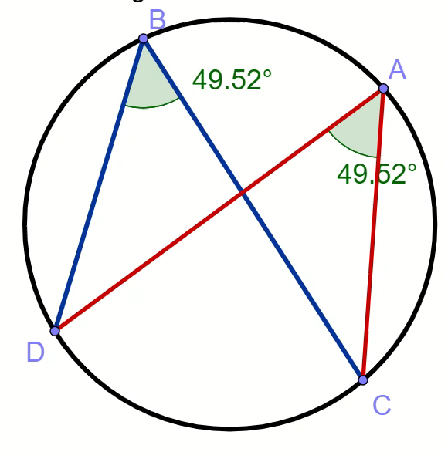
3. Inscribed angles “containing” the same(equal) chords or arcs have the same angles (Rabbit Ears)

Slide 8
Practice: Find the missing angles
Both contain arc BC
Both contain chord AD
Isosceles Triangle
Compl. Angles
Isosceles Triangle

Slide 9
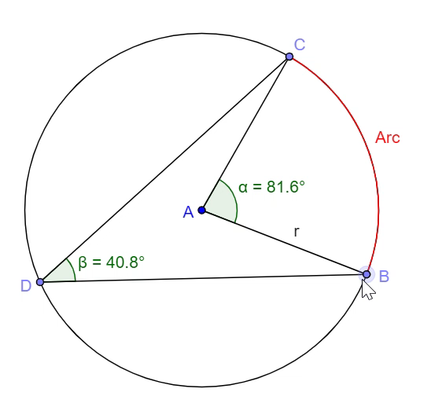
4. The inscribed angle is equal to half of the central angle if they “contain” the same chord or arc
Central Angle Applet
In a situation when the two radii’s are
moved past the center of the circle, the
Central angle will be the outer angle AOB

Slide 10
III) Proving Angle Properties:

Slide 11
Challenge : Find the missing angles
Both contain arc CD
Central angle is double
the inscribed angle
Central angle is double
the inscribed angle

Slide 12

Given:
All inscribed angles from the same(equal)
chord must be the same
Rabbit Ears!!

Slide 13
Ex#1) Prove ΔACB ~ ΔDCE (similar:AAA)
Statement | Reason

Slide 14
Ex #2)

Slide 15
Ex: #3) Find the values of the missing Angles x, y, z
Suppl. Angles
Inscr. Angles of same
chord AD
Compl. Angles with
angle “y”

Slide 16

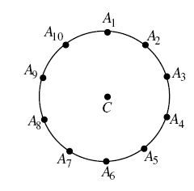


Slide 17
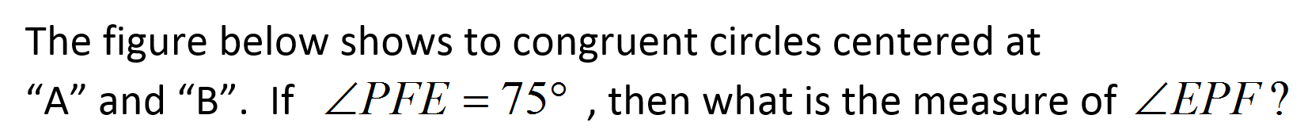
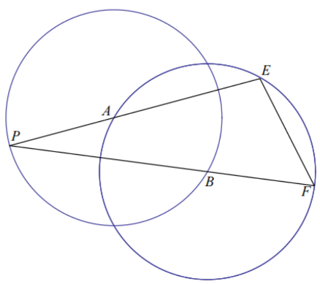

Slide 18
The 1st step is to learn how to draw a picture for this problem
Draw lines that can help you better solve the problem,
Ie: draw a radius or diameter
Now look for other clues, ie: which angles are equal?
Those two angles are equal because they are inscribed by lines with the same length
What can you do next????????
Use the Cosine Law!!!!

